Slide 1


Guilherme Fernandes de Mattos
24/08/2022

Slide 2

Outline
Executive Summary
Introduction
Methodology
Results
Conclusion
Appendix

Slide 3
Executive Summary
Summary of methodologies
Data Collection
Data Wrangling
EDA with Data Visualization
EDA with SQL queries
Building an Interactive Map with Folium
Building a Dashboard with Plotly
Predictive Analysis with Classification Algorithms
Summary of all results
EDA Results
Interactive Analysis
Predictive Analysis

Slide 4
Introduction
Project background and context
SpaceX advertises Falcon 9 rocket launches on its website with a cost of 62 million dollars; other providers cost upward of 165 million dollars each, much of the savings is because SpaceX can reuse the first stage. Therefore if we can determine if the first stage will land, we can determine the cost of a launch.
Problems we want to find answers
How can we determine the cost of a launch?
Can we predict which launches are going to land successfully for reuse?

Slide 5

Section 1

Slide 6
Methodology
Executive Summary
Data collection methodology:
Data have been extracted through API and web scraping and exported to csv
Perform data wrangling
One hot encoding data fields for machine learning and data cleaning of nulls values and irrelevant columns.
Perform exploratory data analysis (EDA) using visualization and SQL
Perform interactive visual analytics using Folium and Plotly Dash
Perform predictive analysis using classification models
LR, KNN, SVM, DT models have been built and evaluated for the best classifier.

Slide 7
Data Collection
SpaceX Launch Data have been collected through two different ways:
API request from the SpaceX REST API
Web Scraping Wikipedia using BeautifulSoup.
SpaceX API
Extract Data in JSON
Normalize into CSV
Data Consolidation and Wrangling
HTML from Wikipedia
Extract Data with BS
Normalize into CSV

Slide 8
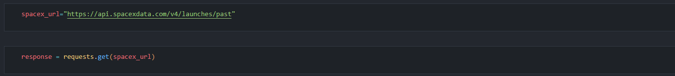
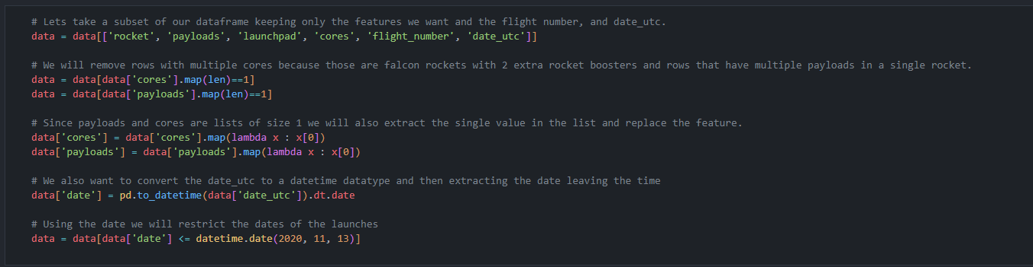
Data Collection – SpaceX API
We used the get request to the SpaceX API to collect data, clean the requested data and did some basic data wrangling and formatting.
Request on SpaceX API
Normalize JSON
Extract and Refine Dataframe
Export to CSV
https://github.com/gfmattos/cr_spacey/blob/main/notebooks/s1-data-collection-api.ipynb

Slide 9
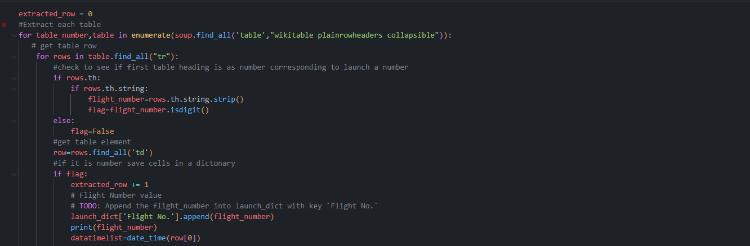
Data Collection - Scraping
We applied web scrapping to webscrap Falcon 9 launch records with BeautifulSoup
We parsed the table and converted it into a pandas dataframe.
Create BS Object
Parse the HTML from Wikipedia Tables
Extract and Refine Data
Export to CSV
https://github.com/gfmattos/cr_spacey/blob/main/notebooks/s1-data-collection-webscraping.ipynb

Slide 10
Data Wrangling
Due to the model which is going to be created, it was necessary to convert the values from Outcome column to a proper label called Class.
Analyze Missing Data
Calculate Launches on each Site
Calculate Occurrence of each Orbit
Handle Null Values
Create the Label Class
Calculate Occurrence of Mission Outcome
https://github.com/gfmattos/cr_spacey/blob/main/notebooks/s1-data-wrangling.ipynb

Slide 11


EDA with Data Visualization
We explored the data by visualizing the relationship between flight number and launch Site, payload and launch site, success rate of each orbit type, flight number and orbit type, the launch success yearly trend.
https://github.com/gfmattos/cr_spacey/blob/main/notebooks/s2-eda-dataviz.ipynb

Slide 12
EDA with SQL
We loaded the SpaceX dataset into a PostgreSQL database without leaving the jupyter notebook.
We applied EDA with SQL to get insight from the data. We wrote queries to find out for instance:
The names of unique launch sites in the space mission.
The total payload mass carried by boosters launched by NASA (CRS)
The average payload mass carried by booster version F9 v1.1
The total number of successful and failure mission outcomes
The failed landing outcomes in drone ship, their booster version and launch site names.
https://github.com/gfmattos/cr_spacey/blob/main/notebooks/s2-eda-sqllite.ipynb

Slide 13
Build an Interactive Map with Folium
We marked all launch sites, and added map objects such as markers, circles, lines to mark the success or failure of launches for each site on the folium map.
We assigned the feature launch outcomes (failure or success) to class 0 and 1.i.e., 0 for failure, and 1 for success.
Using the color-labeled marker clusters, we identified which launch sites have relatively high success rate.
We calculated the distances between a launch site to its proximities. We answered some question for instance:
Are launch sites near railways, highways and coastlines.
Do launch sites keep certain distance away from cities.
https://github.com/gfmattos/cr_spacey/blob/main/notebooks/s3-folium-analysis.ipynb

Slide 14
Build a Dashboard with Plotly Dash
We built an interactive dashboard with Plotly dash
We plotted pie charts showing the total launches by a certain sites
We plotted scatter graph showing the relationship with Outcome and Payload Mass (Kg) for the different booster version.

Slide 15
Predictive Analysis (Classification)
Summarize how you built, evaluated, improved, and found the best performing classification model
You need present your model development process using key phrases and flowchart
https://github.com/gfmattos/cr_spacey/blob/main/notebooks/s4-prediction.ipynb

Slide 16
Results
Exploratory data analysis results
Interactive analytics demo in screenshots
Predictive analysis results

Slide 17

Section 2

Slide 18
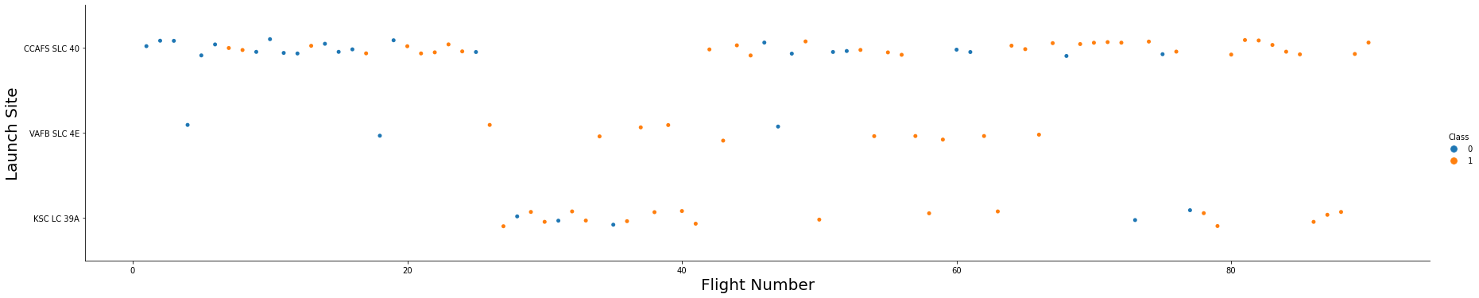
Flight Number vs. Launch Site

Slide 19
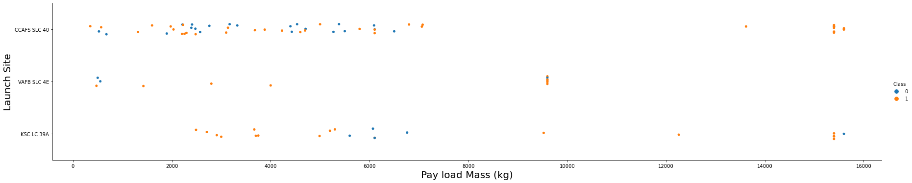
Payload vs. Launch Site
VAFB-SLC launchsite there are no rockets launched for heavypayload mass(greater than 10000).

Slide 20
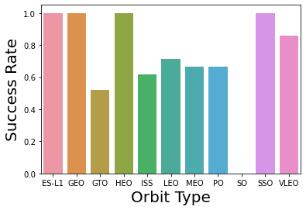
Success Rate vs. Orbit Type

Slide 21
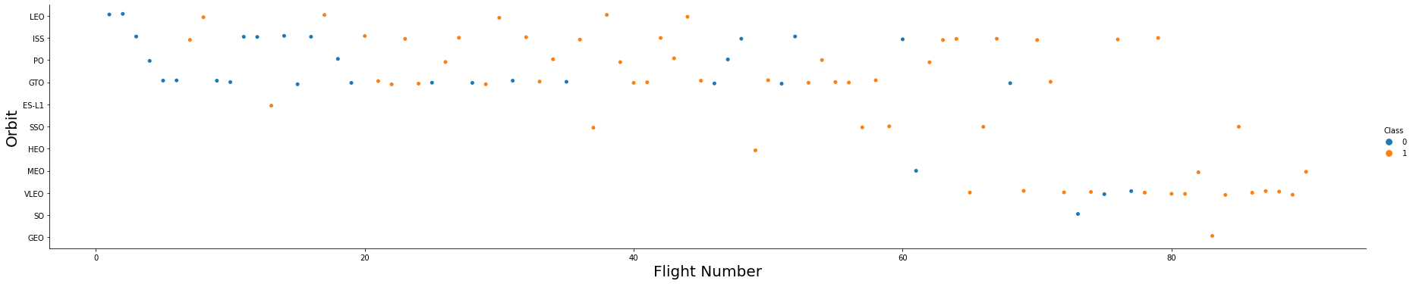
Flight Number vs. Orbit Type
You should see that in the LEO orbit the Success appears related to the number of flights; on the other hand, there seems to be no relationship between flight number when in GTO orbit.

Slide 22
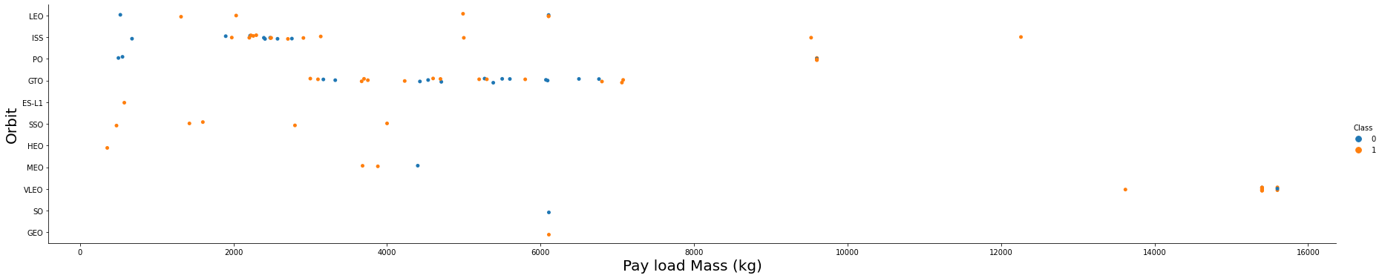
Payload vs. Orbit Type
With heavy payloads the successful landing or positive landing rate are more for Polar,LEO and ISS.
However for GTO we cannot distinguish this well as both positive landing rate and negative landing(unsuccessful mission) are both there here.

Slide 23
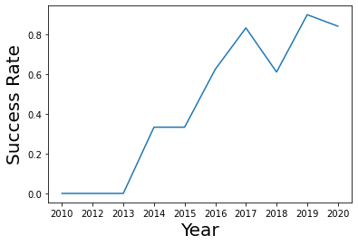
Launch Success Yearly Trend
you can observe that the sucess rate since 2013 kept increasing till 2020

Slide 24
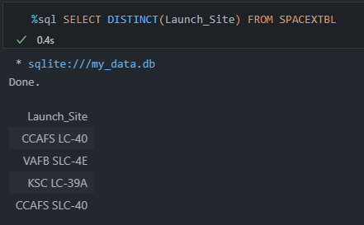
All Launch Site Names

Slide 25
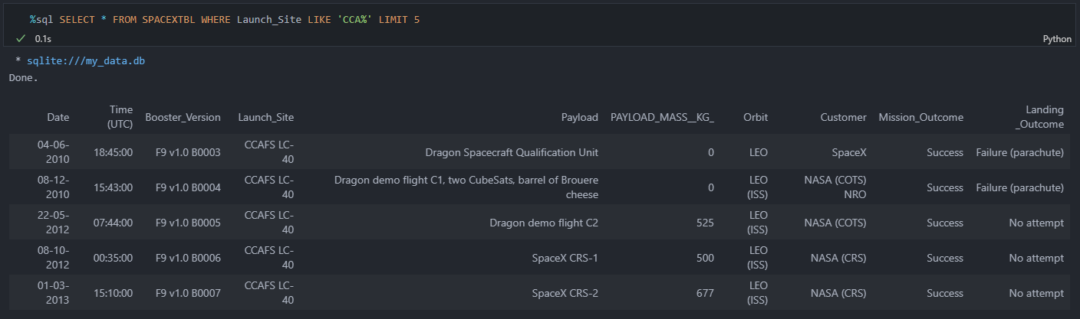
Launch Site Names Begin with 'CCA'

Slide 26
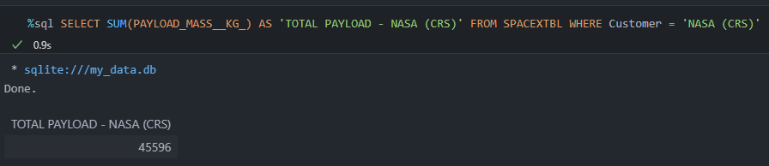
Total Payload Mass

Slide 27
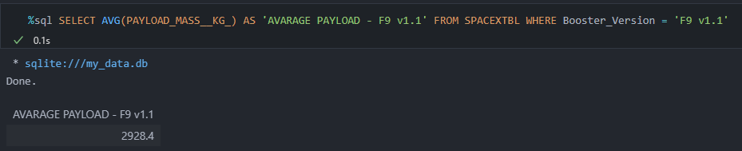
Average Payload Mass by F9 v1.1

Slide 28
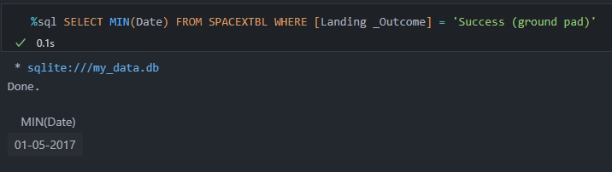
First Successful Ground Landing Date

Slide 29
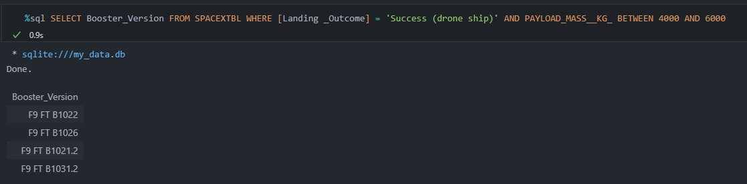
Successful Drone Ship Landing with Payload between 4000 and 6000

Slide 30
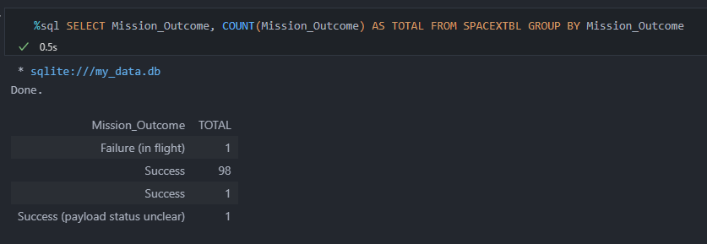
Total Number of Successful and Failure Mission Outcomes

Slide 31
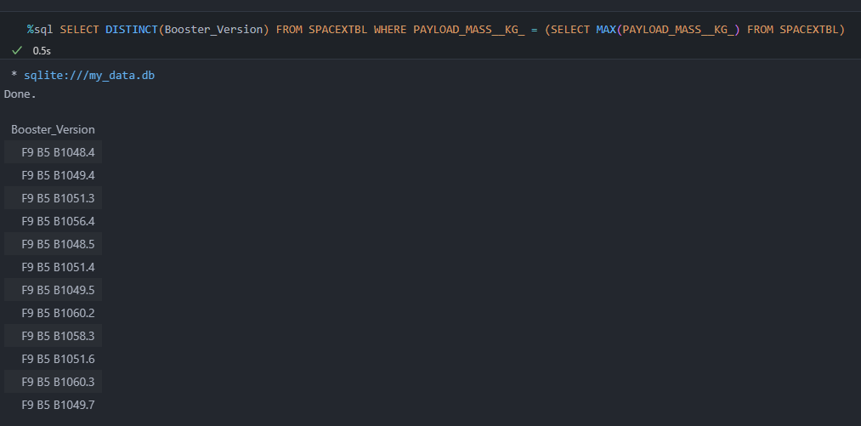
Boosters Carried Maximum Payload

Slide 32
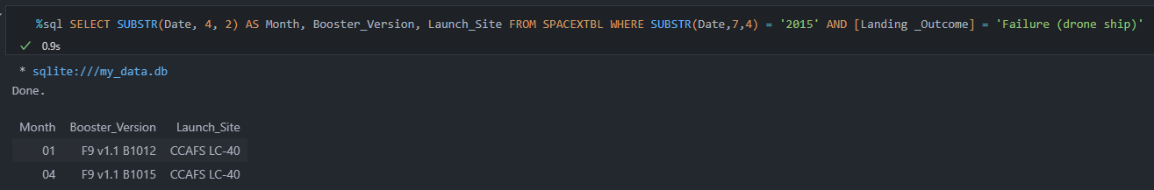
2015 Launch Records

Slide 33
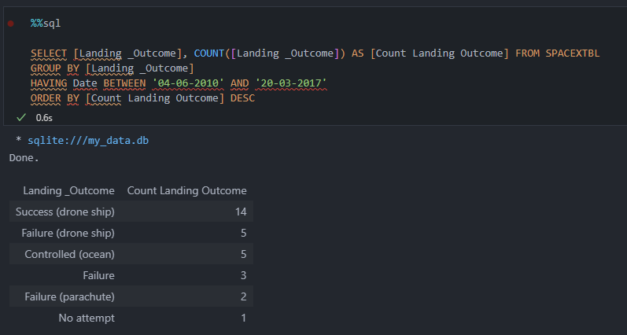
Rank Landing Outcomes Between 2010-06-04 and 2017-03-20

Slide 34

Section 3

Slide 35
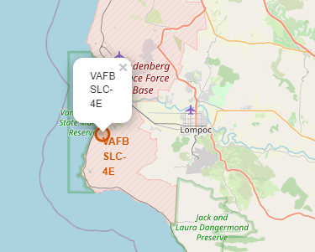
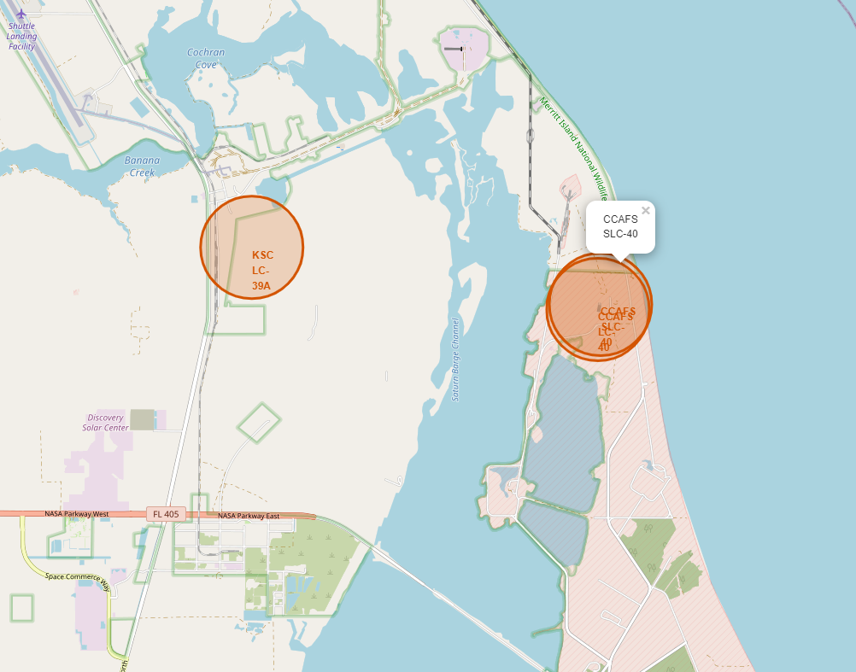
Launch Sites
California
Florida

Slide 36
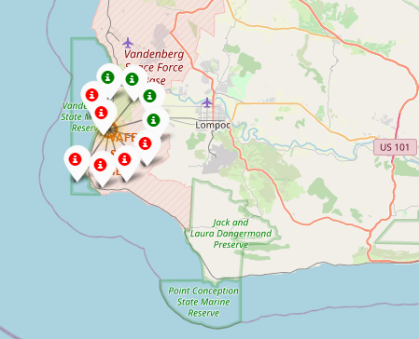
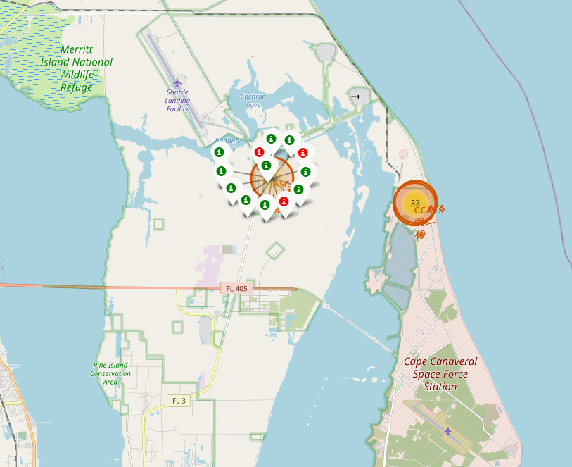
Launch Records
California
Florida

Slide 37
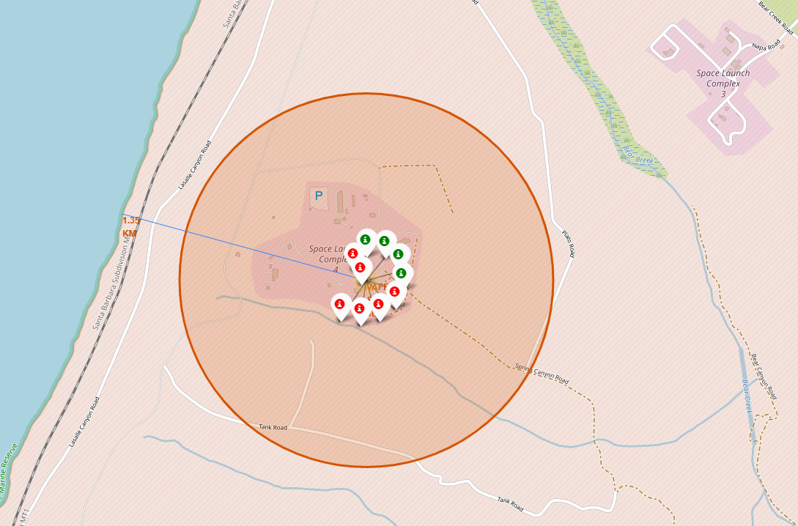
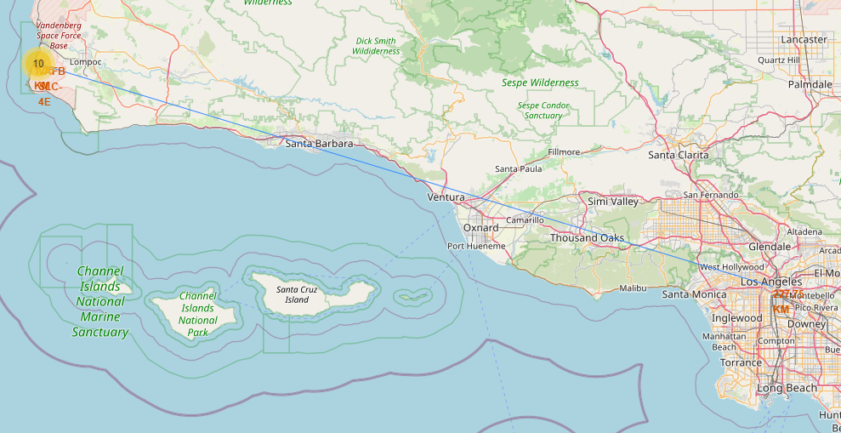
Launch Distances
1.35 KM to the coastline
227,75 KM to Los Angeles

Slide 38

Section 4

Slide 39
<Dashboard Screenshot 1>
Replace <Dashboard screenshot 1> title with an appropriate title
Show the screenshot of launch success count for all sites, in a piechart
Explain the important elements and findings on the screenshot

Slide 40
<Dashboard Screenshot 2>
Replace <Dashboard screenshot 2> title with an appropriate title
Show the screenshot of the piechart for the launch site with highest launch success ratio
Explain the important elements and findings on the screenshot

Slide 41
<Dashboard Screenshot 3>
Replace <Dashboard screenshot 3> title with an appropriate title
Show screenshots of Payload vs. Launch Outcome scatter plot for all sites, with different payload selected in the range slider
Explain the important elements and findings on the screenshot, such as which payload range or booster version have the largest success rate, etc.

Slide 42

Section 5

Slide 43
Classification Accuracy
Visualize the built model accuracy for all built classification models, in a bar chart
Find which model has the highest classification accuracy

Slide 44
Confusion Matrix
Show the confusion matrix of the best performing model with an explanation

Slide 45
Conclusions
Point 1
Point 2
Point 3
Point 4
…

Slide 46
Appendix
Include any relevant assets like Python code snippets, SQL queries, charts, Notebook outputs, or data sets that you may have created during this project

Slide 47


